Slide 1
Introducing critical realism for social science research Workshop 5: Key Concepts in critical realism
Dave Elder-Vass
www.eldervass.com

Slide 3
Which key concepts?

Slide 4
Overview
We can discuss some of…
Emergence, causality, mechanisms and explanation
Structure, agency and social causation
Realism and social construction
Realist approaches to culture
The ‘critical’ dimension of critical realism
Depending on your answers!

Slide 5
Causality
one:

Slide 6
Bhaskar: science and causality
Laboratory science only makes sense if...
many forces interact to cause events
or why would we need labs?
the forces observed operate outside the lab too
or why would there be any point?
The condition of possibility of science
multiple determination of events
by causal powers acting as tendencies
which can be frustrated by interacting powers

Slide 7
emergence and causal powers
Events caused by interacting causal powers
Hence powers are tendencies
Powers are emergent properties of entities
properties of wholes not possessed by their parts alone or organized in some other way
e.g. a dog’s power to bark

Slide 8
mechanisms and powers
Produced by generative mechanisms
depend on the nature of the entity concerned
its parts and the relations between them
Powers may be explained
weak or relational emergentism
But not explained away
Hence not an eliminative reductionism (such as methodological individualism)

Slide 9
retroduction and retrodiction
If events are multiply determined
there are two parts of a causal explanation
Retroduction
identifying a causal power that may operate in many cases
explaining the mechanism that produces it
Retrodiction
identifying the mix of causal powers and how they interact
… to produce a particular event
or a class of similar events

Slide 10
Structure and agency
two:

Slide 11
ontology & social ontology
Ontology: the study of being and becoming
What sorts of things populate the world?
What influence can they have?
Social ontology
What sorts of things populate the social world?
Can there be social causes?
Different theorists employ different ontologies
often without being explicit about it

Slide 12
Archer’s morphogenetic approach
Morphogenesis: “those processes which tend to elaborate or change a system’s given form, structure or state” (Buckley 1967: 58-9) (vs. morphostasis)
The morphogenetic cycle
Structures pre-exist & influence action
Action reproduces/transforms structure
cf. Bhaskar’s Transformational Model of Social Action
Analytical dualism
recognise both so we can analyse interactions
although structure depends on individual action

Slide 13
picturing morphogenesis
Structure
T¹
 | Interaction
 | T² | T³
 |  | Structural elaboration
 |  |  | T⁴
Source: (Archer, 1995:76, Fig 1)
A continuous cycle
Reproduction=morphostasis
Transformation=morphogenesis
Agent influenced by external structural context
And influences it in turn

Slide 14
structural emergent properties
Emergent properties:
depend on lower level but can act back on it
“Emergent properties are therefore relational: they are not contained in the elements themselves, but could not exist apart from them… Nevertheless these ‘feed back’ to condition subsequent interaction at lower levels” (Archer 1982: 475)
Archer applies this concept to social structure
e.g.: Division of labour, education systems

Slide 15
social entities
Can we apply this model to the social world?
What entities, with what powers,
arising from what mechanisms,
interact to produce social events?
People (‘agents’) and material objects
Social structures as specific social entities
with people as their parts
vs. ‘society’ as an integrated whole
vs. mysterious background presences

Slide 16
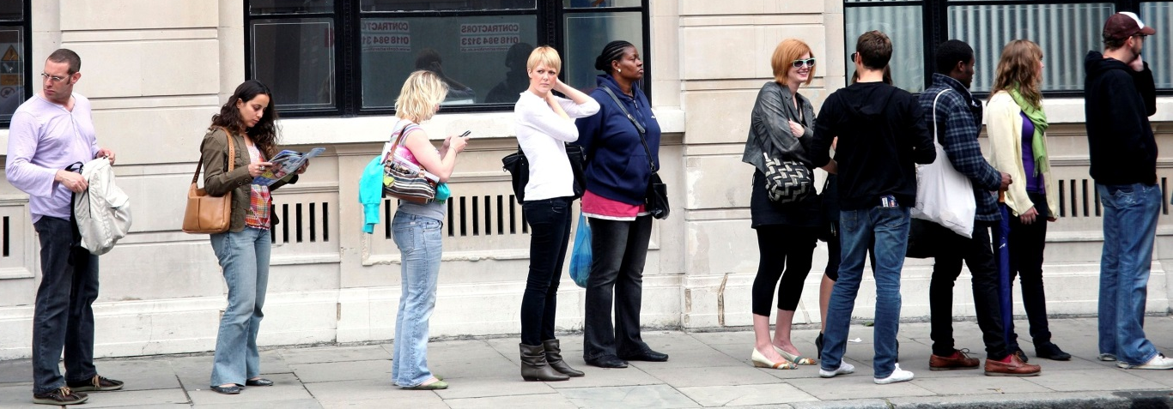
e.g. Queues
Queues share a causal power
capacity to serialise access to a resource peaceably
Because they share its structural basis
composed of people, structured by ordered positioning, produced by shared queuing norms

Slide 17
organisations
Groups of people, structured by
specialised roles – role descriptions as norms
authority relations: roles conferring part of the power of the organization on incumbents
Interactions that arise from role performance
e.g. orchestra, e.g. retail sales people
With emergent causal powers
both members and outsiders act differently than they would in the absence of these relations

Slide 18
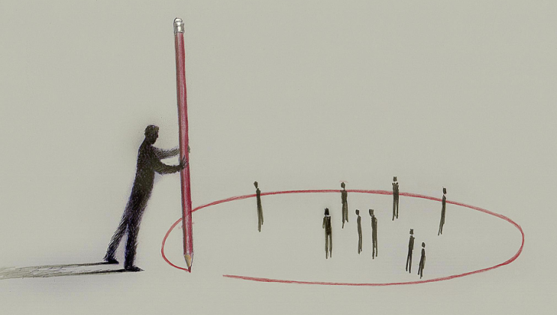
norms and norm circles
Norms as expectations about practices
not always conscious and verbalisable
Normative social institutions?
For every norm there is a norm circle:
the people committed to endorsing and enforcing that norm
norm effectiveness depends on group backing
norm circles not rules cause compliance

Slide 19
norm circle effects
Operating through effects on beliefs
individuals believe they face a social environment where people will reward or penalise them depending on whether they observe the norm
members group believe they act on behalf of a group when they endorse and enforce the norm
Both members and targets act differently than they would in the absence of such groups
Norm circles tend to produce a tendency to comply with the norm

Slide 20
norm circle intersectionality
Norm circles are not necessarily congruent
different norm circles for different norms
they can overlap
they can be clustered
Not a single monolithic normative environment
particularly in contemporary societies

Slide 21
building from norms
Basis for a layered social ontology
Norms shape practices
larger structures emerge from sets of practices
people interact in regularised ways
with each other and things
e.g. organisations
roles as bundles of norm-guided practices
e.g. market systems
emergent from people following market practices

Slide 22
Realism and social construction
three:

Slide 23
social construction
e.g. Berger/Luckmann: The social construction of reality (1966)
processes in which we construct in interaction with each other a shared reality experienced as objective/‘factual’
which then affects how we behave and how we relate to each other
B&L say we experience constructions as real
but constructionists often avoid questions about reality
Can realists be constructionists? should they?
need to distinguish between moderate and radical forms

Slide 24
moderate constructionism
For a realist, what can be constructed?
the social world is concept-dependent
e.g. we accept the powers of governments because we have accepted certain ideas about government
so we can change the social world by changing how people think
structures that depend on how we, collectively, think can be constructed
Separate the transitive and intransitive dimensions
how other people think is intransitive for me, and the social structures I am faced with depend on that
but still independent of what I myself think (the transitive dimension)
so I cannot change them by changing just how I think

Slide 25
the social construction of money
Notes, coins, and bank balances are only money because we agree to treat them as acceptable forms of payment
So money, or its value, is socially constructed
this value would otherwise not exist at all
notes & coins exist physically whatever we think (intransitive)
but being money depends on social construction
i.e. on other people’s beliefs (intransitive)
So the money-ness of those notes is real and intransitive, even though it is socially constructed

Slide 26
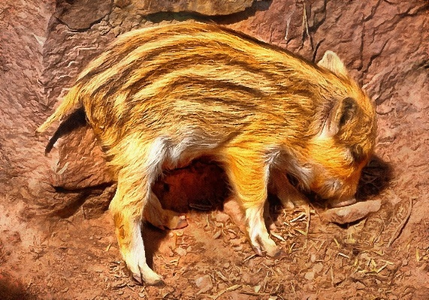
exercise: can it be socially constructed?
atoms and molecules
domestic violence
public opinion
the weather
childhood
reality
the body
the self
animals
nature
mass murder
intelligence
disability
goals in football

Slide 27
the value of constructionism
Political: it enables us to question what was previously taken for granted, e.g. as ‘natural’
e.g. Seidman on race and sexuality
e.g. de Beauvoir: “One is not born, but rather becomes, a woman”
But is it anything more?
if so, we will need to be able to explain how it works

Slide 28
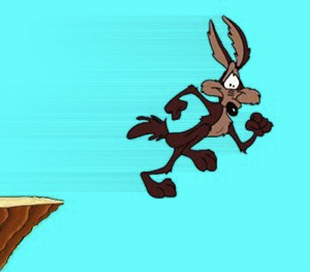
radical constructionism
“what we know as reality is itself a social construction” (Burr...)
“we could use our language to construct alternative worlds in which there is no gravity or cancer, or in which persons and birds are equivalent” (Gergen...)
implies that social constructions are not interpretations of an independent reality, but create our sense of such a reality
depends on belief that we have no access to the world except through discourse

Slide 29
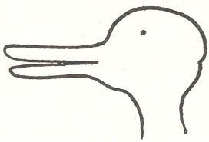

Slide 30
do we have access to the world?
Kant
phenomenological vs noumenal world
access only to impressions, shaped by a priori categories
neo-Kantians
access only to discursive concepts
shaped by socially determined linguistic forms
Realists
we have sensory access to the world
though it is influenced by our concepts

Slide 31
realism and radical constructionism
Is all our thinking about the world radically constructed?
would it be just as sound if they were constructed differently?
or is there something that is not dependent on how we think & talk about it against which we can judge constructions?
Incoherent to deny that we have access to material reality
how could we communicate without perceptual access to sound, text, etc?
Hence material reality can also influence us and we can assess claims against it
ontological realism judgemental rationality

Slide 32
the ontology of social construction
If something is socially constructed, then
what is doing the constructing? and how?
Constructionists vague on causal process
language, discourse, culture as forces at work
I argue all of these are produced by norm circles
groups of people who influence our behaviour
shaping our ideas about what is acceptable, how to behave, and what exists in the social world
creating structures that can have material effects through the actions of people acting on their behalf
e.g. police, e.g. shops that will accept some forms of ‘money’ and not others

Slide 33
summary
Social construction is the outcome of a real causal process
Only those things can be socially constructed that depend on how we think about them
concepts, human behaviour, institutional reality
Still enough to be enormously important
All of these could be constructed differently
but these constructions depend on the exercise of power in symbolic struggles

Slide 34
culture
four:

Slide 35
Archer’s morphogenetic approach
Morphogenesis: “those processes which tend to elaborate or change a system’s given form, structure or state” (Buckley 1967: 58-9) (vs. morphostasis)
The morphogenetic cycle
Structures pre-exist & influence action
Action reproduces/transforms structure
cf. Bhaskar’s Transformational Model of Social Action
Analytical dualism
recognise both so we can analyse interactions
although structure depends on individual action

Slide 36
picturing morphogenesis
Structure
T¹
 | Interaction
 | T² | T³
 |  | Structural elaboration
 |  |  | T⁴
Source: (Archer, 1995:76, Fig 1)
A continuous cycle
Reproduction=morphostasis
Transformation=morphogenesis
Agent influenced by external structural context
And influences it in turn

Slide 37
Archer on culture
A separate morphogenetic cycle
between CEP’s in the Cultural System
and Socio-Cultural interaction
Focused on ‘propositional’ culture
i.e. systems of ideas as recorded in ‘intelligibilia’
which influence people (T1 again)
and are added to/amended by them (T3)
sense of culture as existing beyond people
See debate in (Archer & Elder-Vass 2012)

Slide 38
what is culture? (an alternative answer)
Shared practices…
Ways of acting socially
e.g. when people meet
e.g. how we should dress
Language
e.g. ‘English’
Discourse
e.g. how we should speak about mental illness

Slide 39
what is culture?
Shared practices
with a group of people committed to them
How are they sustained?
as individual beliefs and habits
by pressure from members of the group
i.e. norm circles

Slide 40
norms and norm circles
Norms as expectations about practices
not always conscious and verbalisable
Normative social institutions?
For every norm there is a norm circle:
the people committed to endorsing and enforcing that norm
norm effectiveness depends on group backing
norm circles not rules cause compliance

Slide 41
norm circle effects
Operating through effects on beliefs
individuals believe they face a social environment where people will reward or penalise them depending on whether they observe the norm
members group believe they act on behalf of a group when they endorse and enforce the norm
Both members and targets act differently than they would in the absence of such groups
Norm circles tend to produce a tendency to comply with the norm

Slide 42
norm circle intersectionality
Norm circles are not necessarily congruent
different norm circles for different norms
they can overlap
they can be clustered
Not a single monolithic normative environment
particularly in contemporary societies

Slide 43
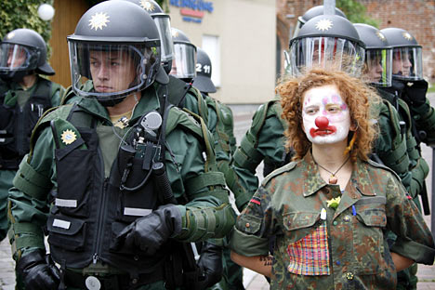
what is a culture?
The myth of cultural integration
every society has divisions and change
varying degrees of cultural integration

Slide 44
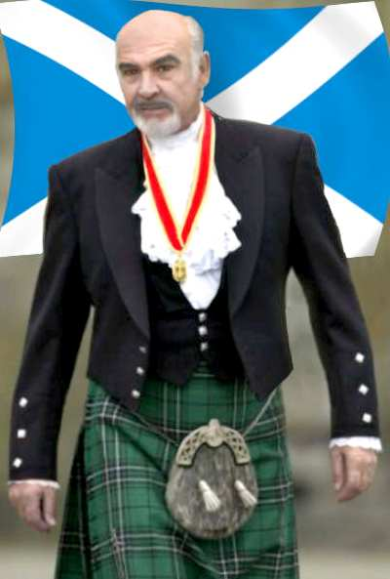
constructing cultures
Often constructed as ‘national’
‘imagined communities’
Only plausible when reflects norm sets
but other boundaries could always be drawn
always a political achievement
Constructions may feed back into allegiances
e.g. nationalism – an ideology that creates the clustering it claims to represent

Slide 45
critique
five:

Slide 46
Bhaskar on critique
Most critical realists take critical positions on society
Bhaskar was interested in how this could be justified
“As a moral realist I hold that there is an objective morality” Bhaskar, DPF, 211
moral truths independent of any person or society
Three attempts to justify this position:
cognitive explanatory critique
needs-based explanatory critique
metareality and the ground state

Slide 47
Bhaskar’s ‘explanatory critique’
Cognitive explanatory critique: if belief P is false (a fact) then P is wrong (a value)
Needs-based EC: if P is responsible for a failure to meet human needs (a fact), then P is wrong
Claims ethical naturalism: the derivation of value from facts
Critics argue that Bhaskar commits the naturalistic fallacy
the premises include value assumptions

Slide 48
Bhaskar’s moral realism
“As a moral realist I hold that there is an objective morality” Bhaskar, DPF, 211
Not just actually existing morality but moral truths independent of any person or society
Values as immanent in practices (DPF)
Values in our ground state (metareality)
Critics argue that objective values are an illusion
values may exist objectively, but they are not objectively right

Slide 49
an alternative realist ontology of values
All critique & values are human products
Exist as individual beliefs or dispositions
emergent mental properties
Acquire status of values through social backing
influence of norm circles
Personal values may diverge
different values may be in competition
This ontology does not justify any given value

Slide 50
realism and critique
Critique is based on values
how can it justify them without moral realism?
We can reason about basic values, without invoking objective values
Ethical reasoning is possible
from facts and basic values to more specific claims
e.g. from ‘value all humans’ to ‘meet basic needs’
Judgemental rationality without moral certainty

Slide 51
building on the discourse principle
one possible rational process for establishing values:
“Just those action norms are valid to which all possibly affected persons could agree as participants in rational discourses” Habermas, Between Facts & Norms, 107
… in discourses that are open, truthful, and undistorted by differences in power
“value all humans”: hard won by the marginalised; de facto outcome of a minimally rational ethical debate

Slide 52
building on ‘value all humans’
an obligation to meet fundamental human needs
food, water, shelter, clothing, recognition, security
see Assiter & Noonan
or to support central human capabilities
life, health, bodily integrity, senses, imagination and emotions
see Sen & Nussbaum
Nussbaum’s version shaped by many discussions with women representing the poor in developing world
Sayer calls this ‘weak ethical naturalism’

Slide 53
responsible critique
The purpose of critique is to influence political practice
provides reasons for change
critics must take responsibility for the possible consequences
Responsible critique has both negative and positive moments
explaining how the status quo prevents flourishing
requires both causal explanation and ethical evaluation
absenting absence necessarily creates a new presence
requiring a vision of alternative structures
which also requires both causal explanation and ethical evaluation

Slide 54
critique requires concrete utopias
The positive moment of critique is utopian
Useful utopias are concrete in Bloch and Bhaskar’s sense
“Concrete utopianism involves a differentiation within the domain of possibilities of those that are real from those that are not. ‘Real’ here means ‘realisable’, and designates which possibilities may be actualised given a particular constraint” (Bhaskar 2016: 125)
As opposed to abstract utopias
which criticise the present by offering imaginary alternatives
Concrete utopias are
not visions of whole alternative ready-made societies, but rather partial models that can be built in practice as elements of the larger social world
provisional and experimental with uncertain outcomes and effects
not visions of perfected final states but steps towards flourishing in dynamic societies

Slide 55
critique requires ethics
Both the negative evaluation of the present and the positive evaluation of utopian alternatives depend on ethical commitments
“Critical social science needs to acknowledge its often hidden or repressed premise – that its evaluations of practices imply a conception of human flourishing” (Sayer, 2011, p. 245)
We need to make those ethical commitments explicit both so that our motivations are understood and in order to justify our conclusions
We may also offer justifications for them, e.g. through a Habermasian discourse ethics
“Critique itself works by influencing the ethical reasoning, the values and the decisions of others. As such it is part of a social process that begins from prevailing social values and leads through ethical debate and material interactions to the reproduction but also the gradual transformation of those values” (Elder-Vass, 2010, p. 49)

Slide 56
critique requires explanation
The negative moment of critique depends on explaining how the target of critique causes harm
The positive moment depends on explaining how the concrete utopia would enable flourishing instead
And on why we can claim it is a realisable alternative
requiring attention to the mechanisms involved, but also evaluation of likely outcomes (Schoppek, 2021)
these evaluations are necessarily fallible and open to debate but remain essential to advocating the alternative
without them we have no way of distinguishing concrete and abstract utopias

Slide 57
Wright’s real utopias
Wright advocates “real utopias”
“utopian ideals that are grounded in the real potentials of humanity, utopian destinations that have accessible waystations, utopian designs of institutions that can inform our practical tasks of navigating a world of imperfect conditions for social change” (Wright, 2010, p. 6)
including both theoretical proposals “attentive to realistic problems of institutional design and social feasibility”
and actual innovations “that embody in one way or another emancipatory alternatives to the dominant forms” (Wright, 2010, p. 1)
e.g. participatory city budgeting, Wikipedia, the Mondragon co-operatives, and unconditional basic income
Multiple, incomplete, provisional, designed at a variety of scales

Slide 58
Q&A

Slide 59
thank you!
remember to tell us what activities you would like to take part in after the workshops end

